Slide 1

AI-Powered Fraud Call Detection System for SSN & Immigration Scam
Team 6 (SafeLine) — INFO6245 | Planning & Managing Information Systems
Team Members: Krisha Lakhani• Hemin Dhamelia• Riya Patel

Slide 2
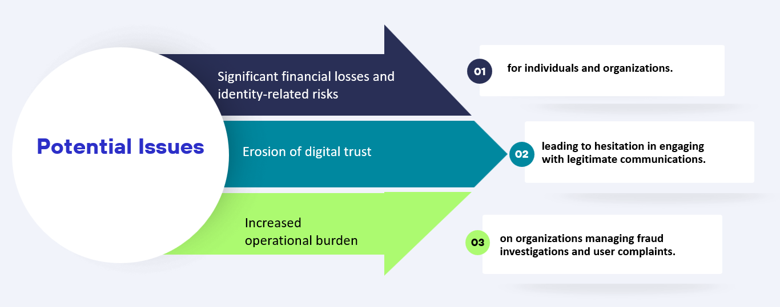

Problem & Opportunity
In 2023, phone scams cost U.S. consumers an estimated $25.4 billion. Even a 10% reduction would save over $2.5 billion annually. Additionally, the FTC reported total consumer fraud losses of $12.5 billion in 2024 across all contact methods.
Despite call-blockers, users lack a system that gives real-time risk scoring based on patterns, caller history, and known fraud datasets.
Opportunity: Build an AI-driven fraud detection engine that analyses incoming calls, detects fraud signals, and provides actionable alerts — increasing security, trust, and data-driven intelligence.

Slide 3







Why We Selected This Project ?
1
2
3
4
5
Rich Learning Opportunity
Organizational Alignment
Real-World Impact
Team Strengths
Feasibility
Fraud calling is a major, unsolved real-world problem, which makes this solution socially impactful.
It combines data science, machine learning, telecom integration, cybersecurity, and user experience, giving our team a rich end-to-end learning opportunity.
It supports organizational objectives in risk mitigation, customer safety, innovation, and trust+brand reputation.
It aligns with our team's strengths and academic background in AI, Python, data engineering, and analytics.
It has clear feasibility within the project timeline whilst offering room for future expansion.

Slide 4










Project Vision & Goals
Create a secure, intelligent, real-time fraud call detection system leveraging machine learning and caller verification APIs.
02
04
Integrate
Provide
01
Integrate telecom APIs (e.g., Twilio Lookup) to fetch caller reputation data.
03
Provide monitoring dashboards for fraud trends and insights.
05
Develop
Build
Ensure
Develop a classification model trained on known scam patterns.
Build a user-facing alert system for incoming calls.
Ensure scalability, feasibility, and alignment with stakeholder expectations.

Slide 5
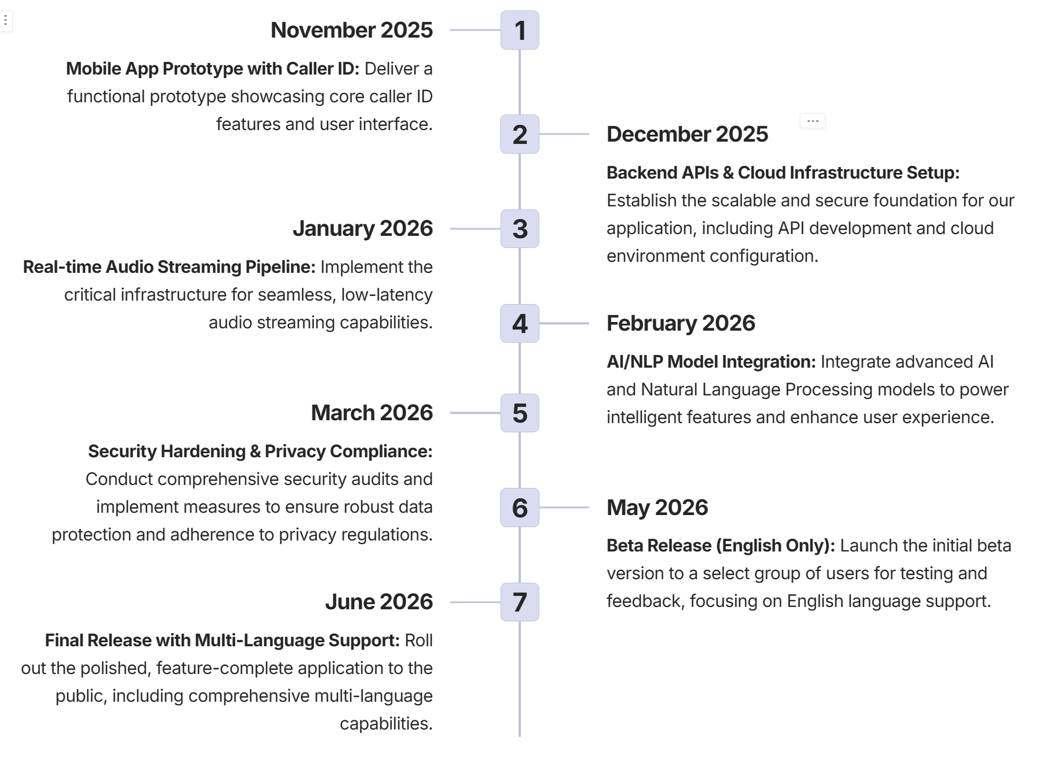
Project Charter and Project Plan
Key Requirements
Mobile app + caller ID verification (MVP)
Real-time AI/ML audio analysis
Backend APIs for fraud detection
Secure data handling + telecom integration
Multi-language support
Expected Benefits
Reduce financial losses from scam calls
Protect at-risk populations from identity theft
Enable subscription/enterprise monetization
Support compliance with emerging fraud-reduction standards
Resources & Costs
$500K–$750K estimate; team includes mobile devs, backend engineers, AI/ML engineers, data engineer, security engineer, QA, and telecom SME
MVP identifies over 80% of scam calls while maintaining a false positive rate below 10%

Slide 6

Work Breakdown Structure
Feature 1: Caller ID Verification
Feature 2: Basic Fraud Detection
Release 1
Mobile App Prototype
Feature 1: Fraud Detection AI Model
Feature 2: User Alerts
Release 2
AI Integration
Feature 1: Telecom Integration
Feature 2: User Reporting & Analytics
Release 3
Beta Testing & Scaling
End-to-end fraud detection MVP with telecom integration, user alerts, and analytics.
Final Deliverable

Slide 7








Gantt Chart
01
Project Kick-off & Alignment
05
AI/ML Model Training & Validation
Team onboarding, requirements understanding, and initial coordination.
Train model for scam detection using collected datasets and run validation tests.
02
Caller ID Verification Setup
06
Backend & App Integration
Implement telecom API integration and caller identity lookup.
Integrate ML model, backend APIs, and ensure app–server communication.
03
Fraud Detection Foundation
07
Alerts, Testing & Analytics
Rule design, scam dataset collection, and preprocessing.
Implement user alerts, conduct beta testing with telecom partner, and develop reporting/analytics.
04
Mobile App Development Prototype
08
Scaling, Development & Project Closure
Build core UI + integrate caller ID and fraud detection basics.
Performance scaling, full deployment, lessons learned, and project wrap-up.

Slide 8
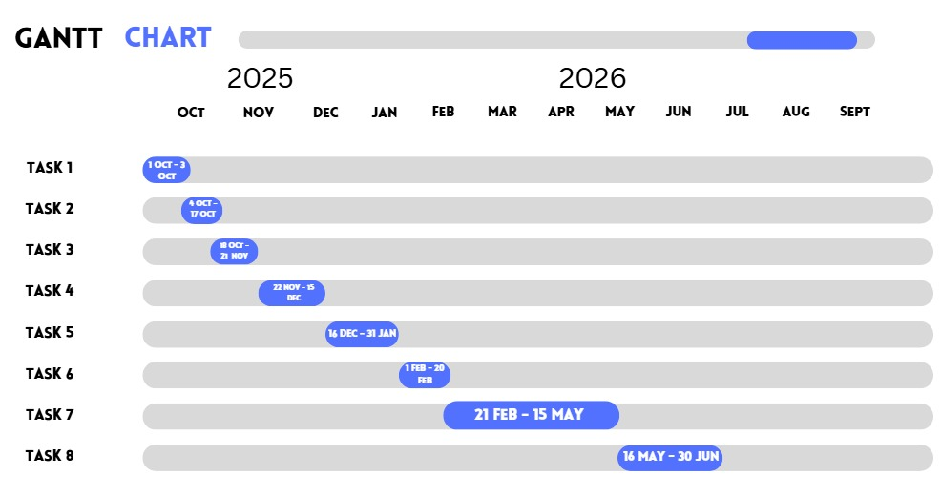

Slide 9
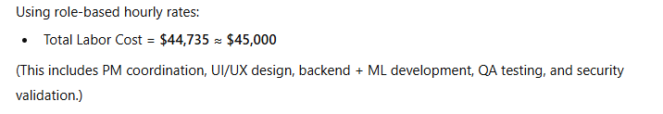



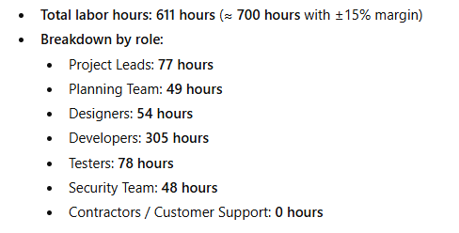
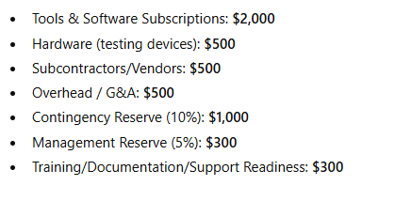
Budgetary Estimate
Labor Effort
Labor Cost
Additional
01
02
03
Total Budget Needed (MVP)
➡️ $50,100

Slide 10
Test Cases
🧪 Key Test Case Highlights (Reporting & Analytics)
Dashboard loads correctly with personalized fraud data
Fraud alerts update in real time when a new scam call is detected
Users can securely export or download fraud reports
All tested scenarios passed functional, performance, and security checks
📊 Competitive Positioning Overview
Capability Area | Industry Apps | Our App
Real-time scam detection | Available in some apps | Built-in, AI-driven
Caller ID & lookup | Common | Supported + enhanced with fraud scoring
Alerts & blocking | Standard | Real-time, behavior-based alerts
Analytics & reporting | Basic/limited | Advanced user dashboard + insights
Multi-language & fraud focus | General security | Specialized for SSN & immigration scams
Telecom integration | Moderate | Planned partnerships for deeper integration
Privacy & security | Varies | Encryption + minimal data retention

Slide 11
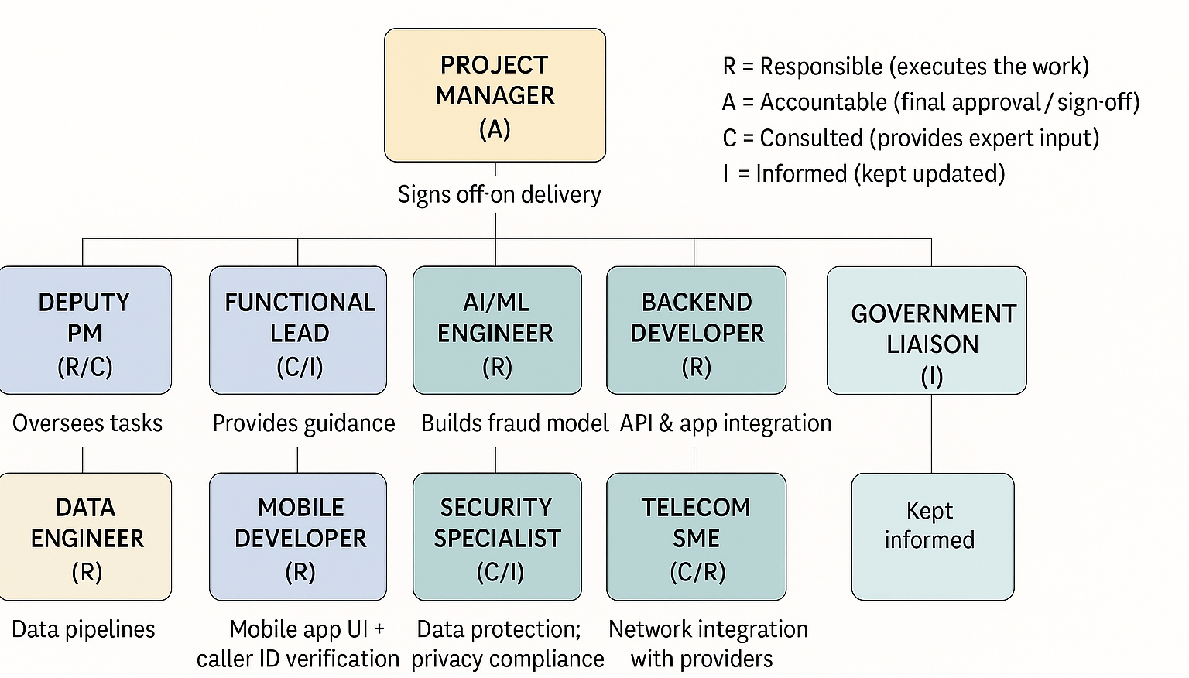
Team Org Chart & RACI

Slide 12
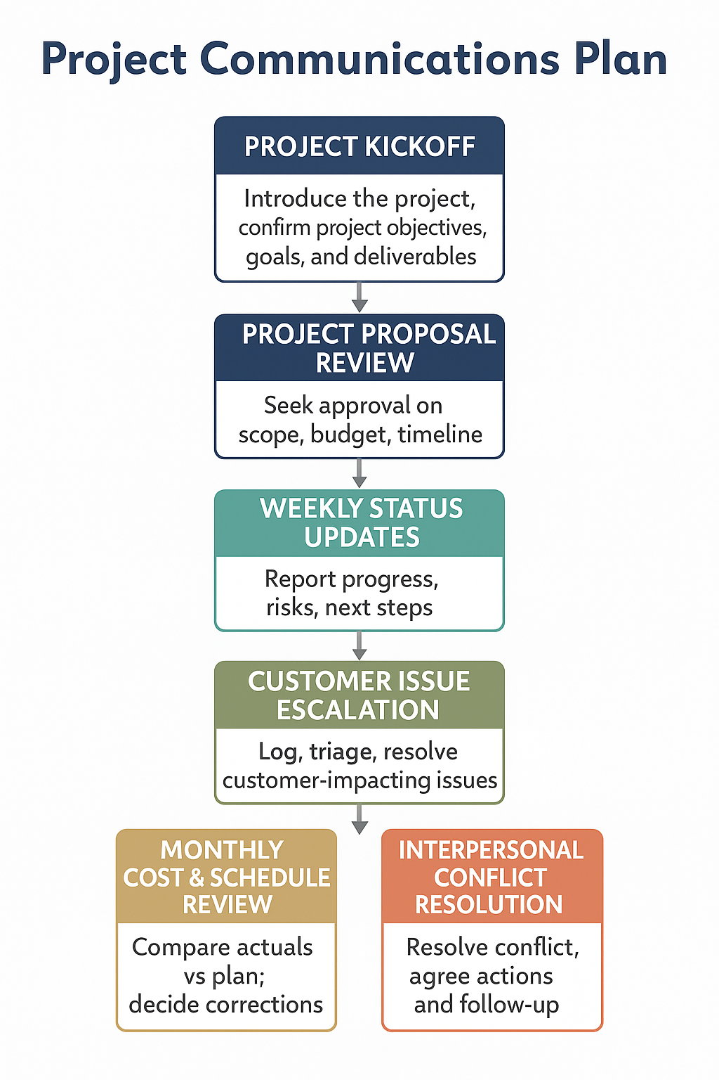
Stakeholder
Communications
Plan

Slide 13
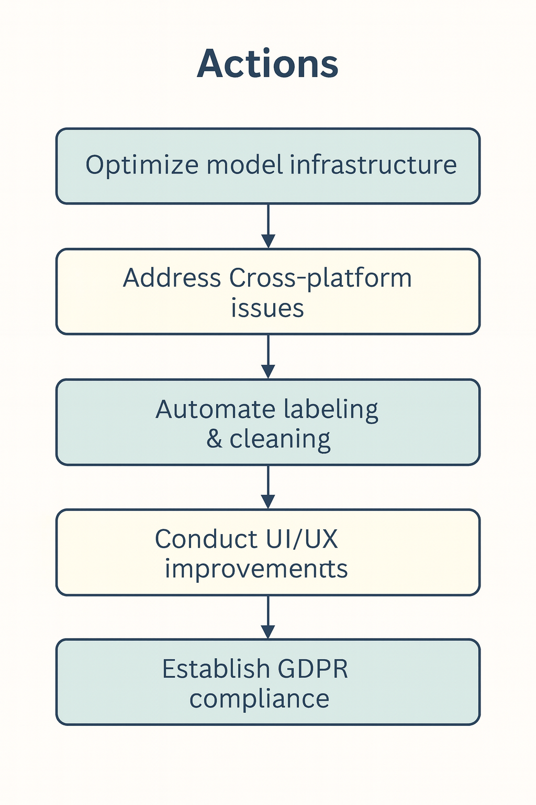




S.W.O.T Analysis
S
W
Skilled AI/ML team
High detection accuracy
Fast prototyping capability
Integrated real-time system
Limited ML infrastructure
Cross-platform challenges
Manual data labeling
O
T
Government-focused demand
Predictive analytics growth
Telecom AI adoption
Evolving scam tactics
Strict data regulations
Strong market competitors

Slide 14
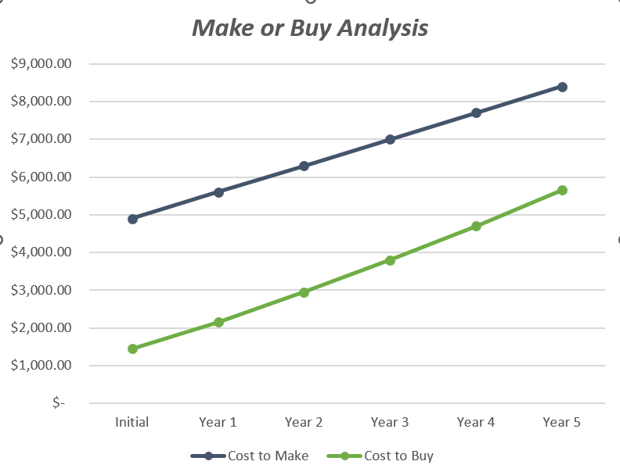
Make or Buy Analysis
Category | Cost to Make (Build Internally) | Cost to Buy (Twilio Lookup API)
Initial Setup Cost | $4,900 | $1,450
Ongoing Annual Cost (Years 1–5) | $700/year | $700–$950/year
Total 5-Year Cost | $8,400 | $5,650
Key Components | - Backend build + security + telecom SME - Developer labor (system setup) - Hosting + ML pipeline infra - Data labeling + model tuning - Maintenance + bug fixes - Security updates & compliance | - Twilio contract + onboarding - API subscription & usage fees - Integration development - Minor maintenance - Security & regulatory compliance
Cost Trend | Increases steadily due to infra + tuning | Grows mildly, remains lower
Overall Result | Higher cost, higher complexity | Most cost-effective option (≈33% cheaper)

Slide 15
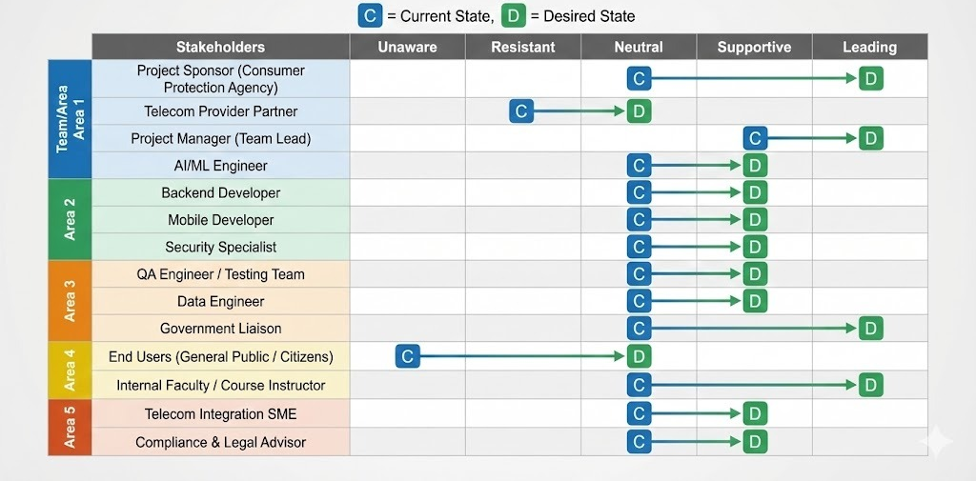
Stakeholder Engagement Assessment

Slide 16
THANK YOU
“We might just help you avoid a fraud in the future.”
Questions? We’re happy to answer.

